Slide 1
Introduction to ML.NET
Presented by
MD. Amjad Hossain
Software Engineer
Secure Link Services BD Ltd
SELISE | Amjad

Slide 2
What is Machine Learning

Slide 3
What is Machine Learning
Programming the unprogrammable

Slide 4
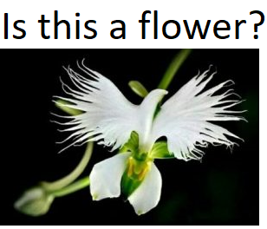
What is Machine Learning
Programming the unprogrammable
f(x) {

Slide 5
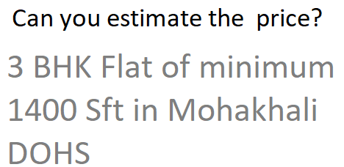
What is Machine Learning
Programming the unprogrammable
f(x) { f(x) {

Slide 6
What is Machine Learning
Programming the unprogrammable
f(x) { f(x) {
Model Model

Slide 7
What is Machine Learning
Programming the unprogrammable
f(x) { f(x) {
Model Model
Machine Learning creates this function using data

